Slide 1
A QUICK INTRODUCTION TO SPATIAL STATISTICS
Parmanand Sinha
Research Computing Center
University of Chicago

Slide 2
OUTLINE
Spatial Data
Spatial Data Types and Formats
GIS software
Spatial Analysis
Spatial Econometrics
Geostatistics
Spatial Analysis Software

Slide 3
TYPES OF SPATIAL DATA FORMATS
Vector (points, lines and polygons) vs Raster (grid).
Vector:
ESRI Shapefile is the near universal standard now.
Google kml
Raster:
Lots of formats for rasters, but rasters are rarely encountered in spatial analysis of socio-economic data.

Slide 4
SHAPEFILES
A "shapefile" is actually a group of 3+ files with the same name but different extensions.
.shp, .shx, .dbf, optional files include .prj, .shp.xml, .sbn, .sbx, ...
Just make sure that they all stay together, and never try to edit them outside of a GIS package.
Topology?

Slide 5
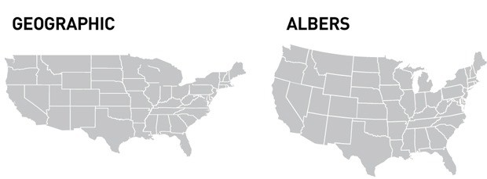
GEOGRAPHIC PROJECTIONS

Slide 6
GEOGRAPHIC OR PROJECTED COORDINATES?
Geographic coordinates: latitude and longitude
Non-Euclidean, so don’t try calculating area, perimeter or distance.
Projected coordinate systems have converted lat/lon to x/y,
Introduces distortion.
Useful for calculations, and for visualization.
Project if you need to do geographic calculations. Caveat, most GIS provide routines for great circle distance, so you can use these.

Slide 7
GIS SOFTWARE
ArcGIS is the industry leader.
Open-source mapping and visualization software: QGIS
R/Python for Analysis

Slide 8
WHY USE A SPATIAL LINEAR MODEL?
If there are omitted covariates with a spatial pattern, or if there are spatial dependencies, then,
At best, OLS t-statistics are too large, and
At worst, OLS coefficients are biased and inconsistent.

Slide 9
TYPES OF SPATIAL DATA: EXAMPLES
Fields:
Temperature, rainfall, accessibility
Networks/Lattices
County tax rates
Point Patterns
Tree locations.
Disease locations.

Slide 10
TYPE OF SPATIAL PATTERNS: EXAMPLES
Each type of data has its own methods, and often, its own software.
It’s not always easy to determine which type is appropriate:
Houses with values: Field? Network? Point Pattern?
Census tracts with average house values: Network? A field/point pattern that has been aggregated?

Slide 11
TYPES OF SPATIAL DATA: PROCESSES
Fields (aka Geostatistics)
Usually specified by an autocovariance function. Cov(e_{i}, e_{j} ) = C(d_{ij; α})
Lattices/Networks (aka Spatial Econometrics)
Usually specified by an interaction matrix (spatial weights matrix)
Point Patterns
Usually modeled similarly to Fields, but dependencies are possible for both point density and attributes.
Can be tricky: if points are clustered, is it because they are mutually dependent, or do they appear clustered only because they depend upon some underlying covariate.

Slide 12
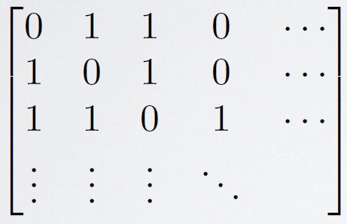
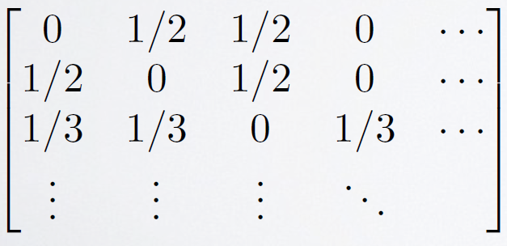
DEFINING RELATIONS IN A NETWORK/LATTICE
The weights matrix W specifies connections. It is usually based on contiguity of regions.
The weights matrix is often “row standardized” so that it is a spatial moving average.

Slide 13
WEIGHT MATRIX DEFINITIONS
Binary contiguity is the most common for area-type data.
Distances between centroids:
K nearest neighbors (kNN).
fixed radius
Contiguity, with weights based on length of border.

Slide 14
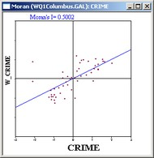
EXPLORATORY ANALYSIS: MORAN’S SCATTERPLOT
A plot of weighted average of neighbors vs the original observations.
The correlation coefficient is called Moran’s I.
In general, testing whether I=0 is difficult. Most routines provide methods that are based on resampling.

Slide 15
SPATIAL LAG VS SPATIAL ERROR MODELS
Spatial Lag Model
Y = ρWY + Xβ + e
Spatial Error Model
Y = X β + u
u = λWu + e
Computation and interpretation of coefficients is much easier for the error model.

Slide 16
SPATIAL LAG MODEL
Y = ρWY + Xβ + e
If the lag model is true, but you fit OLS, then the coefficients are biased.
Dedicated software will do it correctly.

Slide 17
LAG OR ERROR?
Lagrange Multiplier Test
but, statistically, it can be difficult to distinguish between the two. These tests seem to have low power in finite samples.

Slide 18
GEOSTATISTICS
Y= Xβ + e; Cov(ei, ej ) = f(dij )
The basic geostatistical model is nothing other than Generalized Least Squares (GLS), but with specialized terminology.
The autocovariance function f() is the “covariogram.”
Covariogram parameters are “nugget”, “range” and “sill.”
Prediction is called “kriging,” but it’s just Best Linear Unbiased Prediction (BLUP).

Slide 19
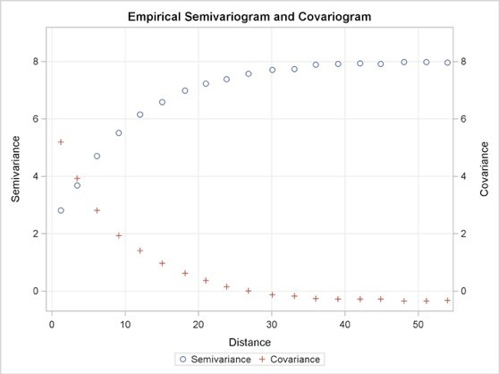
GEOSTATISTICS
Covariogram = a function for distance decay in covariances.
Semivariogram and covariogram just inverses.
For reasons that aren’t relevant to us, the original geostatistician preferred the semivariogram to the covariogram.

Slide 20
FITTING COVARIOGRAM MODELS
Plot the empirical semivariogram, and then fit a curve to it.
You can’t use just any curve, there are some mathematical constraints on it.
So use dedicated software.

Slide 21
SPATIAL STATISTICS SPATIAL ANALYSIS SOFTWARE
SAS - Fits geostatistical models (PROCs VARIOGRAM, KRIGE2D). SAR-Error: by coercing PROC MIXED. SAR-Lag: No.
R does everything, but the learning curve is high.
GeoDa: Really good for beginners. Slighter learning curve.
https://geodacenter.github.io
PySAL: python library. Similar to GeoDa, but more extensible.
ArcGIS generally not recommended for any statistical tasks.

